Slide 1
University Model
Rahul Bhiwande (001040583)
Urvi Aryamane (001040582)
Sneha Ravichandran (001096251)

Slide 2
Agenda
Problem Statement & Objective
Proposed Solutions
Performance Metrics Analysis Table
Object Model
Sequence Diagram
Dashboard Graphs
UI Snippets

Slide 3

Problem Statement & Objective
To use software engineering design and programming techniques to improve the quality of education globally
To develop a performance measuring metric to quantify and improve the student’s professional growth through the quality of education and feedback.

Slide 4
Proposed Solution
The Performance metrics algorithm will be able to provide us an analysis on the course impact based on the below metrics.
Student’s GPA:
The student’s GPA is calculated by taking the average of the course GPA’s attained by the student.
Student’s Professional Performance:
A student's professional performance needs to be calculated by considering the promotions (5), salary increments (5), and awards (5) received by the student multiplied by the employer rating (10).
Employer rating is a score given to the employer on a scale of 10; the bigger the company is, the more difficult it is for a person to get recognition in such companies than smaller startups.
Course Impact:
Course impact is calculated by considering the total number of courses and their types taken up by the student during their education and comparing them to the type of domain they work.

Slide 5
Performance Metrics Analysis Table
Course Impact(%) | Student’s Professional Performance(150) | Student’s GPA(4) | Analysis
<38% | <40 | >3.0 | Courses had no impact The courses need to be tuned in order to meet the industrial standards.
<38% | <40 | <3.0 | Courses had medium impact on the student Student’s performance needs to be improved.
>38% | >40 | >3.0 | Courses had high impact Student also performed well
>38% | <40 | >3.0 | Courses had medium impact Slight tuning of courses to meet industrial standards.
>38% | >40 | <3.0 | Courses had high impact Student could have performed better in studies.
<38% | >40 | <3.0 | Courses had no impact and student’s marks do not matter
>38% | <40 | <3.0 | Courses had medium impact and the student could have performed better
<38% | >40 | >3.0 | Courses had no impact and the student has performed well

Slide 6
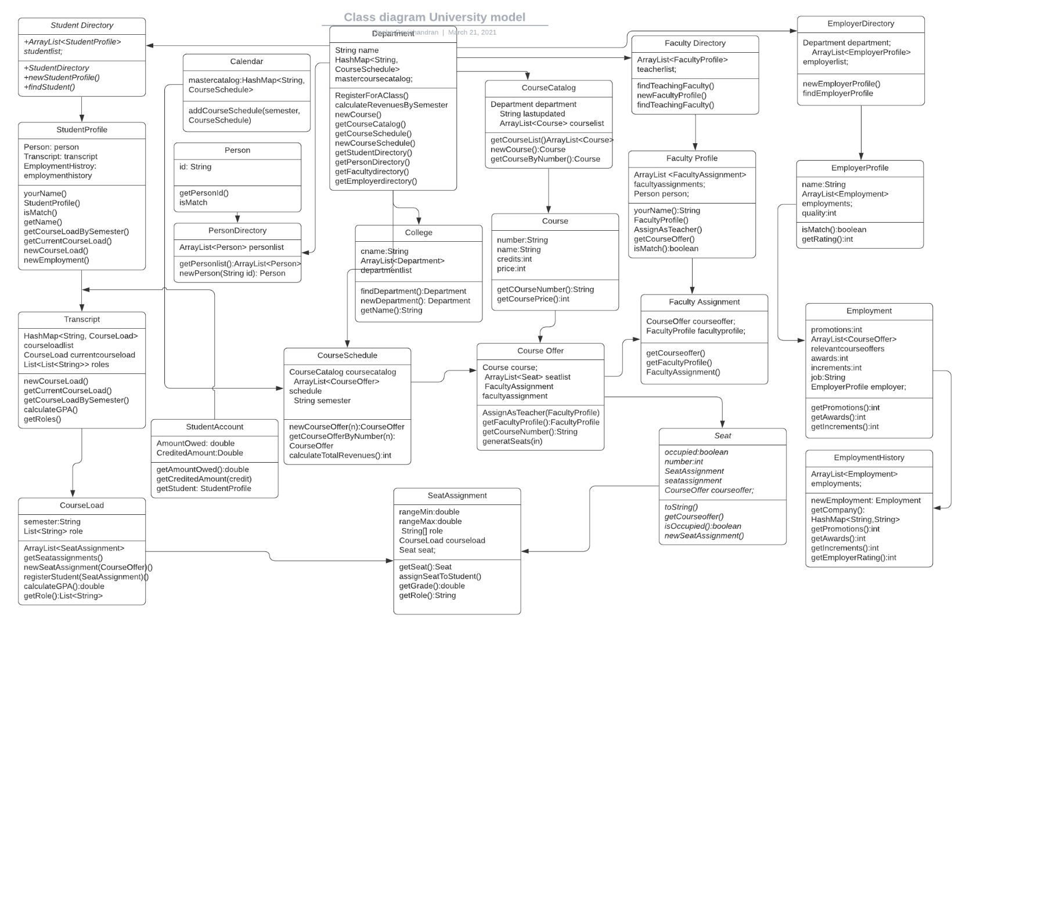
Object Model

Slide 7
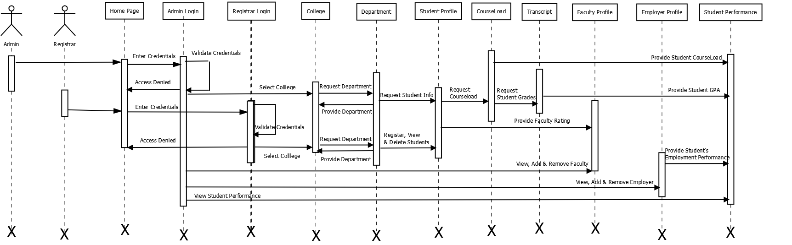
Sequence Diagram

Slide 8
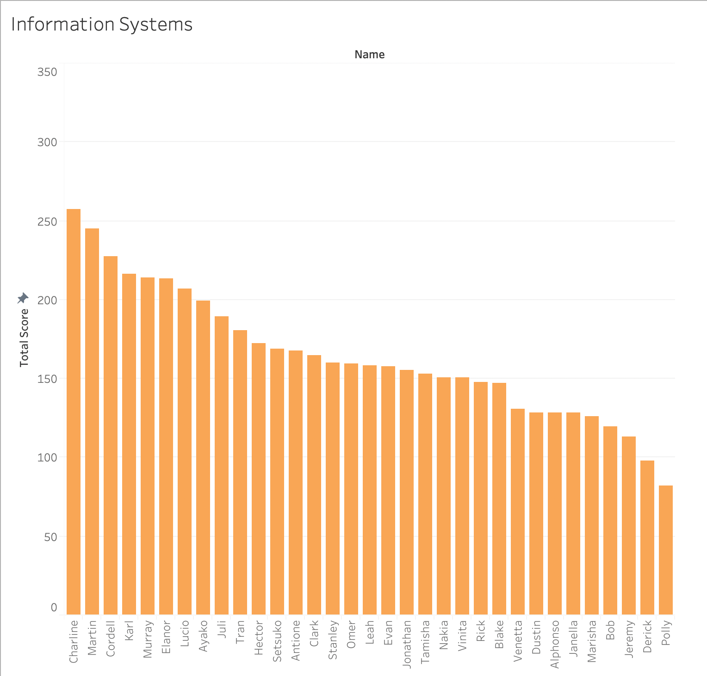
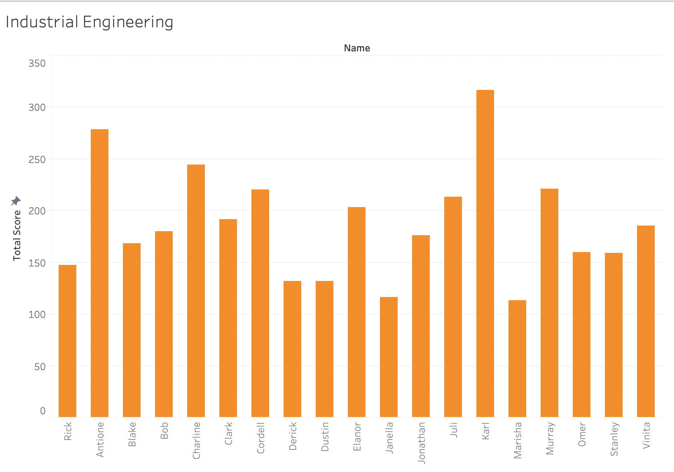
Dashboard Graphs

Slide 9

UI Snippets
Home Page

Slide 10
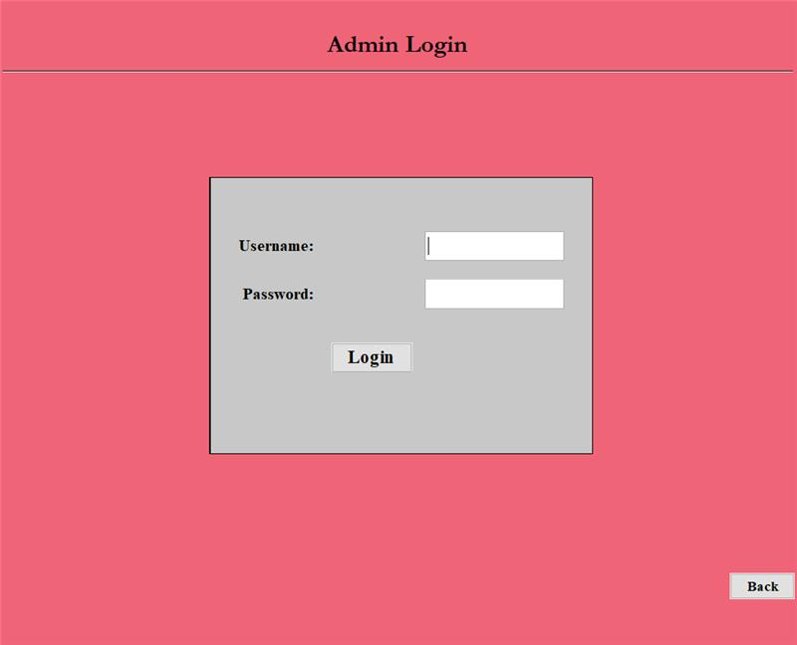
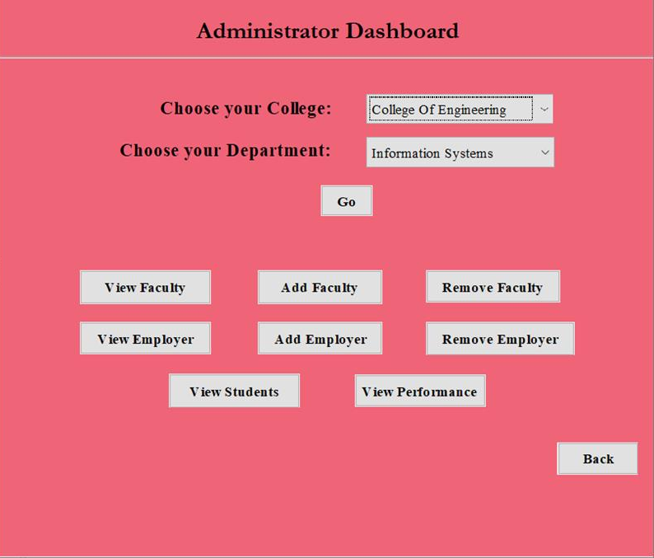
Admin login and Dashboard

Slide 11
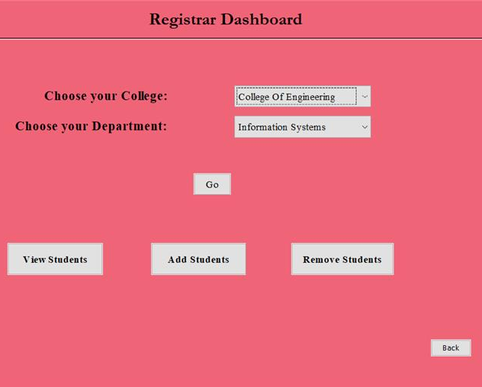
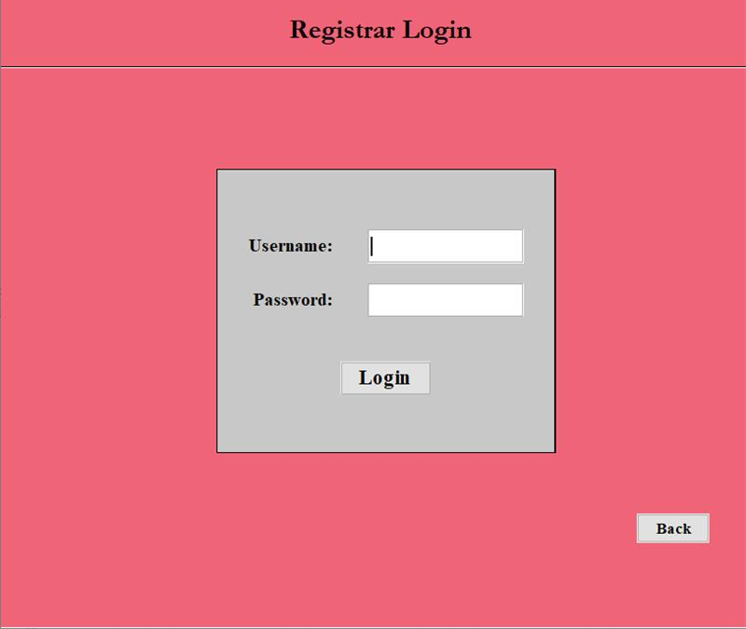
Registrar Login and Dashboard

Slide 12
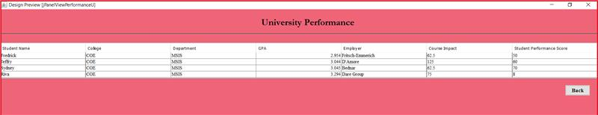
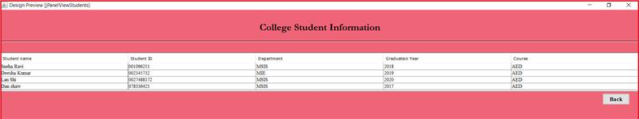
University Performance & College Student Information

Slide 13
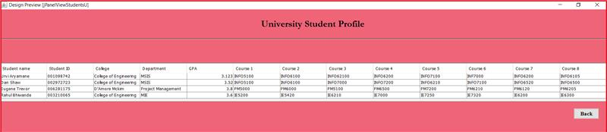
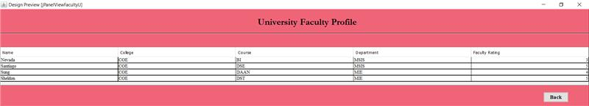
Student and Faculty Profile

